Slide 1
KIND 360 – Engagement Story
June 12, 2020

Slide 2
Agenda
360 Project
Key Analyses and Insights
Activation Effectiveness
Notes:
Discussion Points:
NL Data
MediaCom Data
AOP Methodology and Scope
Data access – DBP Team
Weekly Tracker Data Upload
Nielsen FTP Credentials

Slide 3

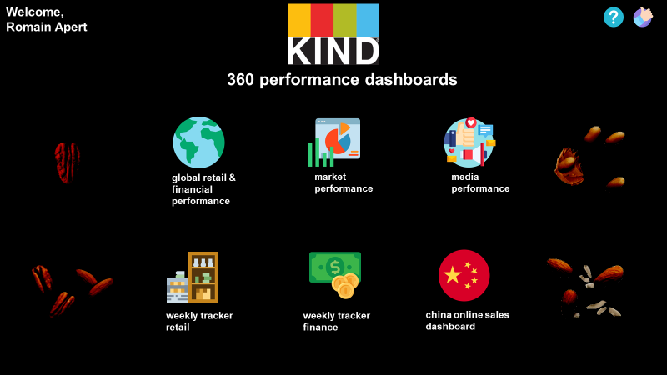







The KIND 360 Project serves as the foundation of the analytical journey embarked by KIND by acting as a one-stop shop for data and reducing time to insight
DATA
HOW MIGHT WE?
VALUE
Data – driven decisions
Nielsen Data
Dunnhumby Consumer Data
Mediacom Media Data
Holistic Performance
Assessment
Helios Financial Data
One Platform. All Data.
Manual Uploads
Faster Insights
Across lenses like Customer, Product, Consumer, Media, Finance

Slide 4
Agenda
360 Project
Key Analyses and Insights
Activation Effectiveness
Notes:
Discussion Points:
NL Data
MediaCom Data
AOP Methodology and Scope
Data access – DBP Team
Weekly Tracker Data Upload
Nielsen FTP Credentials

Slide 5

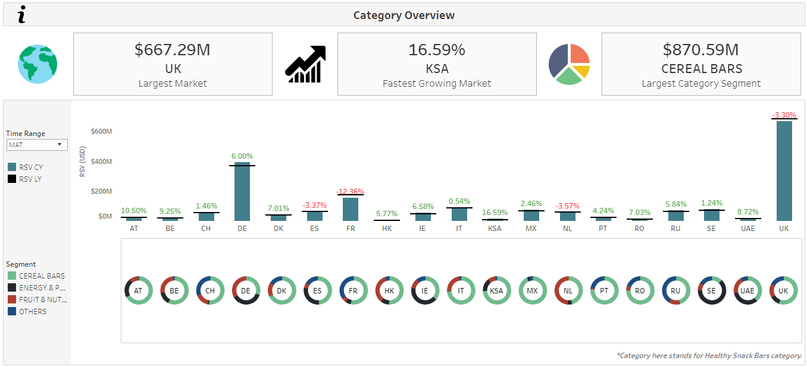

Category performance tracker along with segment fragmentation gives an overview of market size and growth
1
2
UK is the largest market by category
Kingdom of Saudi Arabia is growing the fastest
How might we?
Understand which markets are the largest markets in the category?
Which markets are growing the fastest?
How are the segments spread across markets?
Do we have the right portfolio in all markets?
1
2
3
4
4
Italy’s biggest segment is “Cereal Bars” – Do we have the right portfolio available?
3
Sweden has major market for “Energy and Performance” segment

Slide 6
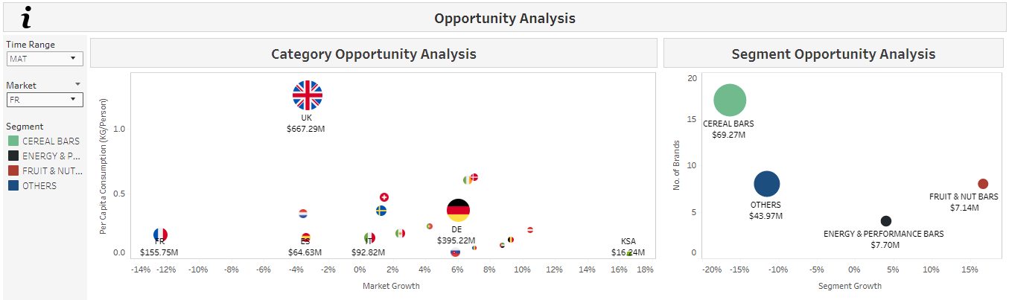
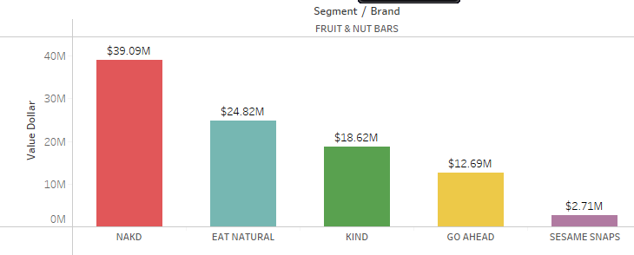
Opportunity analyses aid in identifying the markets and segments of key interest based on consumption and competition
2
1
In France, “Fruit and Nut” is the fastest growing and doesn’t have a lot of brands
UK has a high consumption per person and a healthy growth rate
How might we?
Identify key markets to focus on based on consumption and market growth rate?
In that specific market – which segments are the most important?
Which competitor brands are present in that segment and how am I performing with respect to them?
1
2
3
3
“Fruit and Nut” Segment is dominated by “NAKD Brand” – whereas KIND comes in at 3rd place

Slide 7
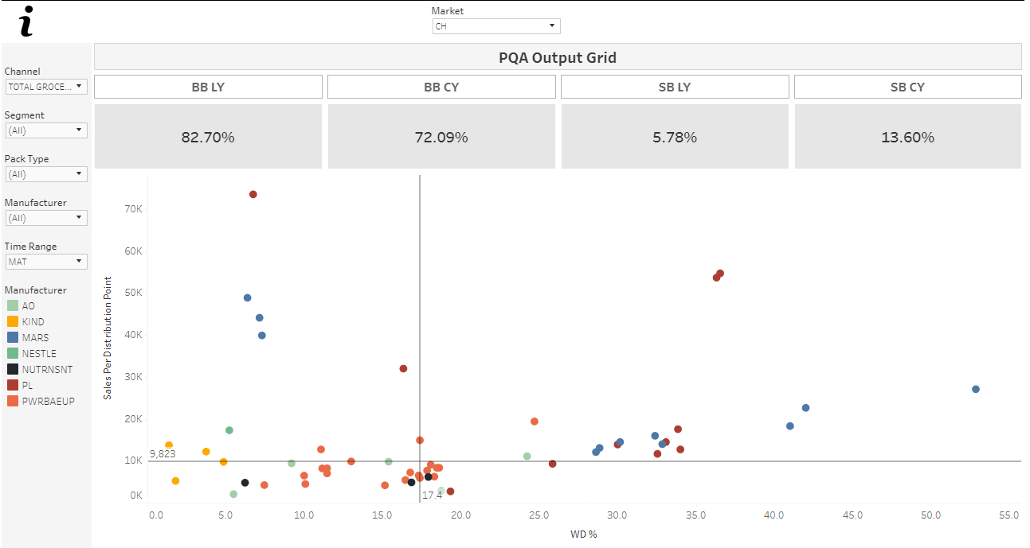
Product Quadrant Analysis helps in gauging portfolio performance and aids in portfolio management by identifying the right set of products
1
72% of portfolio are block busters
How might we?
Identify share of high and low performing SKUs in portfolio
Understand which products need a higher distribution
Decide which SKUs need to have reduced distribution
Identify SKUs whose distribution needs to be maintained
1
2
2
4
Sleeping beauties
Increase distribution to drive the highest volume lift
Blockbusters Maintain current distribution to sustain sales
3
4
2
3
Lame Duck SKUs
These SKUs have a lot of potential – might see increased sales if distribution is increased
Weakening Core SKUs
Aim to reduce distribution since they don’t sell well even with high distribution

Slide 8
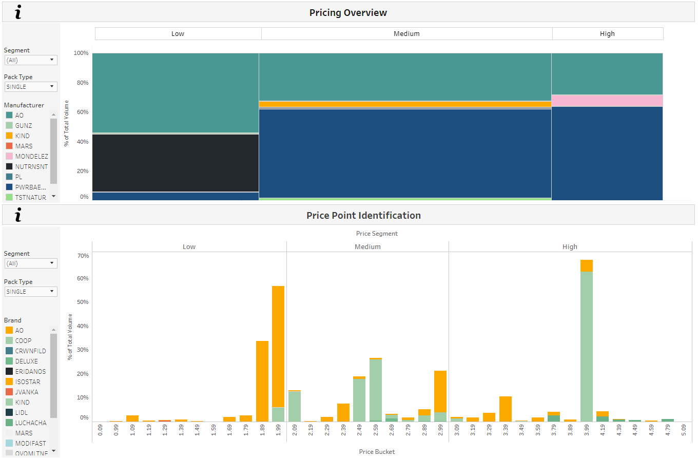
Pricing analyses help in understanding the pricing landscape of a market and identifying hit price points
1
In Switzerland, “Medium” segment is biggest – with KIND being present majorly in that segment
How might we?
Which is the biggest price segment within a country?
To identify the key competitor brands present within the price segment and their share?
To identify hit price points within each price segment and to decide if KIND needs to be closer to that price range
1
2
3
4
CHF1.89 and CHF 1.99 are the hit price points
3
KIND is performing well compared to most brands

Slide 9
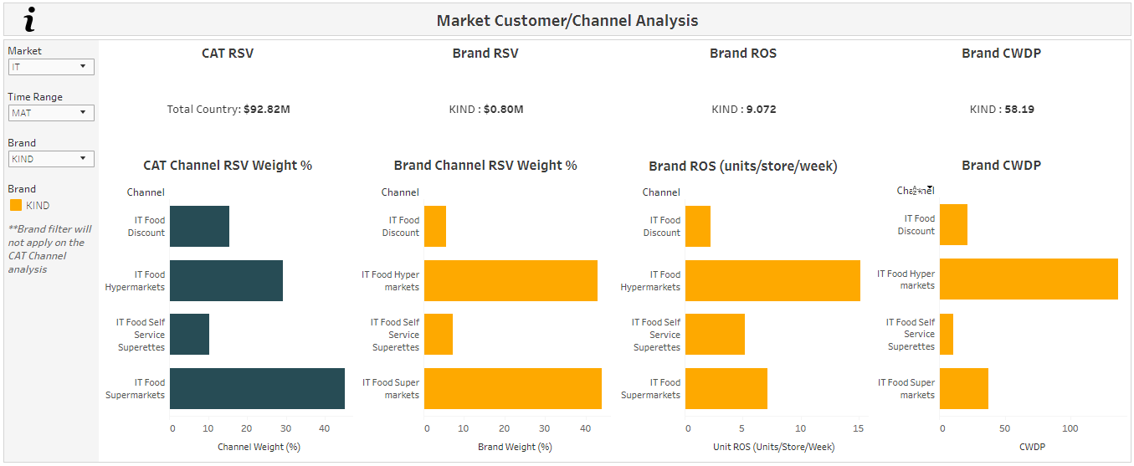
Channel analysis helps to understand total category and brand sales distribution by channel
3
The rate of sale for KIND is maximum in hypermarkets
How might we?
Which is channel contributes most to the total category sales?
To identify which are the key channel driving the sales of the brand?
To gauge the rate of sale and cumulative distribution across channel?
1
2
3
1
In Italy the supermarkets has the largest sales contribution
2
KIND share of sales is almost equally distributed between hypermarkets and supermarkets

Slide 10
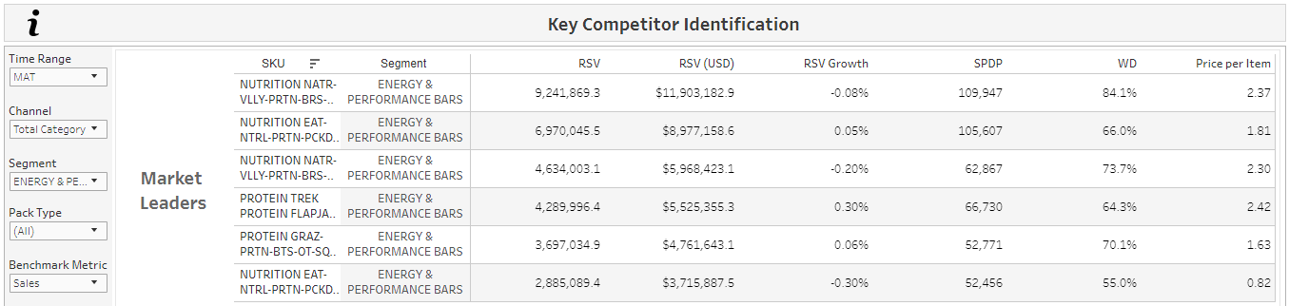
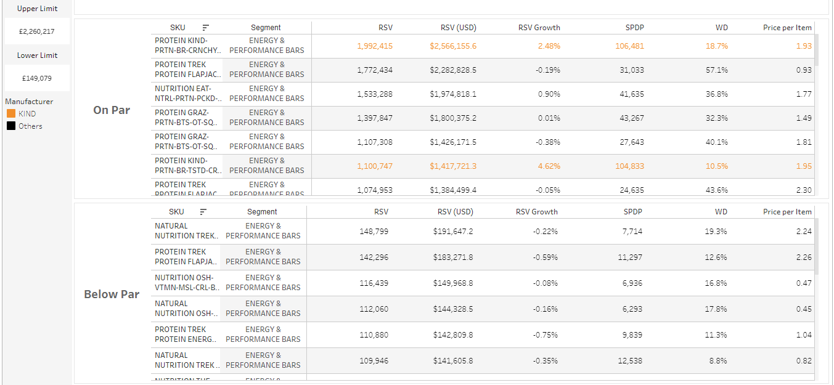
Key Competitor identification classifies and segments the products based on the their value sales for various product characteristics.
1
How might we?
In UK the market leaders have
value sales of more than 2.2M pounds
What are the top products contributing to value sales?
To identify the key competitor for KIND in a segment?
1
2
2
KIND in protein segment has competitors

Slide 11
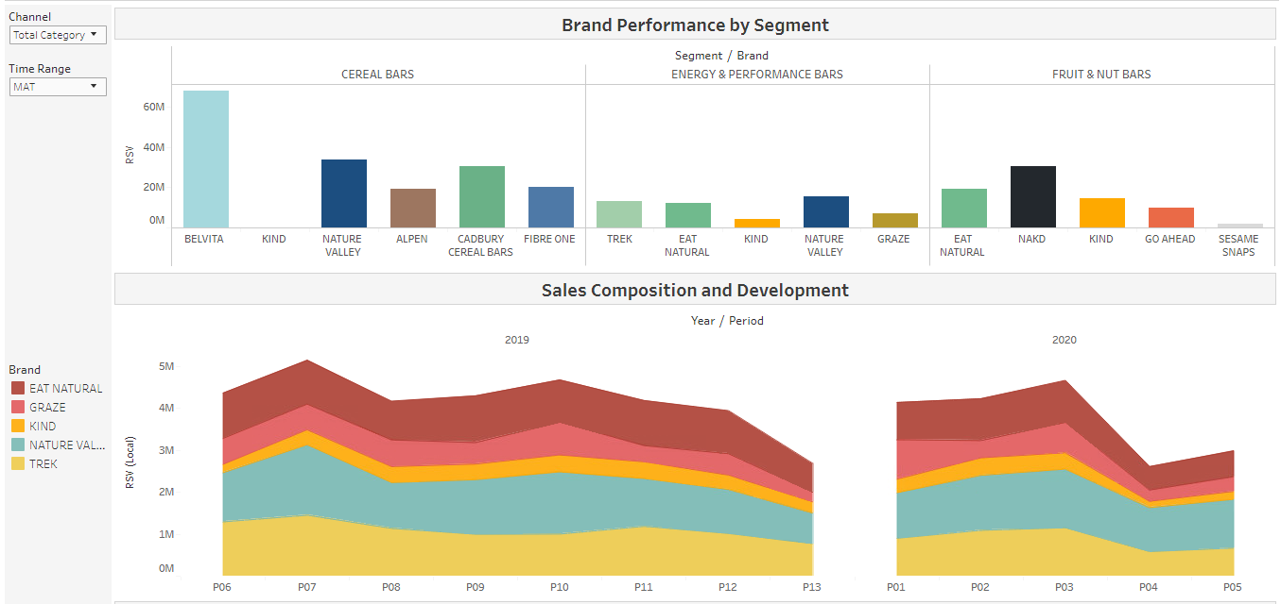
Brand performance by segment and sales development helps to track & compare sales progression over time.
1
KIND’s biggest competitor is ‘Nature Valley’ in Energy segment
How might we?
What are the top competitors in a segment to KIND?
What are the sales trend and distribution among the top 5 brands compared o KIND in a segment?
1
2
2
Sales composition for KIND remains similar across time .

Slide 12
Agenda
360 Project
Key Analyses and Insights
Activation Effectiveness
Notes:
Discussion Points:
NL Data
MediaCom Data
AOP Methodology and Scope
Data access – DBP Team
Weekly Tracker Data Upload
Nielsen FTP Credentials

Slide 13
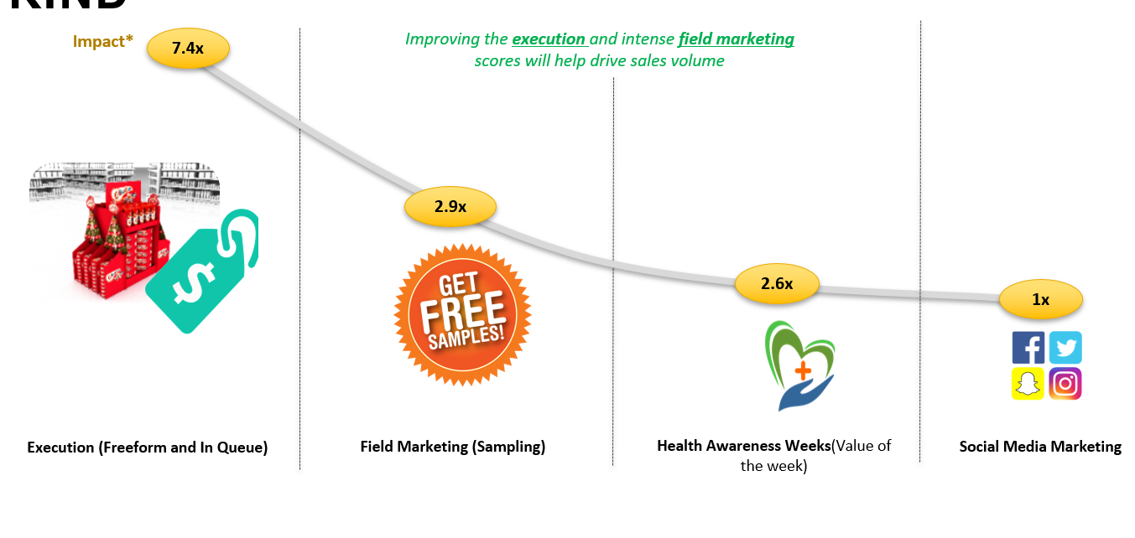


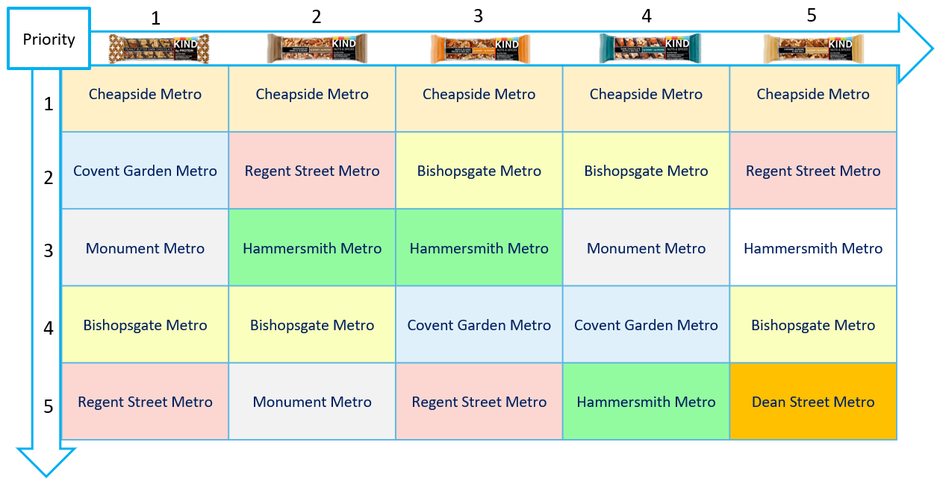

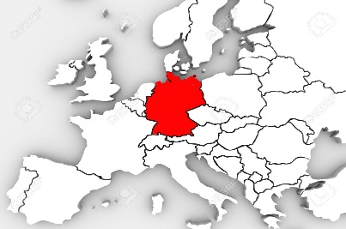

We successfully piloted an activation effectiveness exercise to identify the most significant drivers/activations of sales and quantify their impact
KEY INSIGHTS
How might we improve and scale it?
Isolated the effect of each activation driver using advanced machine learning algorithms
Quantified impact of each activation drivers on sales
Recommended product and store prioritization for sampling and in-store execution
New Data Sources
Inclusion of data sources, IRI, etc. to identify additional drivers of sales
Finance data to optimize trade expenditure with respect to ROI
3
2
Granular data with new metrics
Data at a week level
More metrics like promotional distribution
1
Understand how activation drivers like In-store Execution, Price, Field Marketing, Sampling strategy and social media etc. is affecting sales
New customer and geographies
Expand to new markets and customers across same market(UK)

Slide 14
Data Quality Management An unified quality and error detection tool

Slide 15
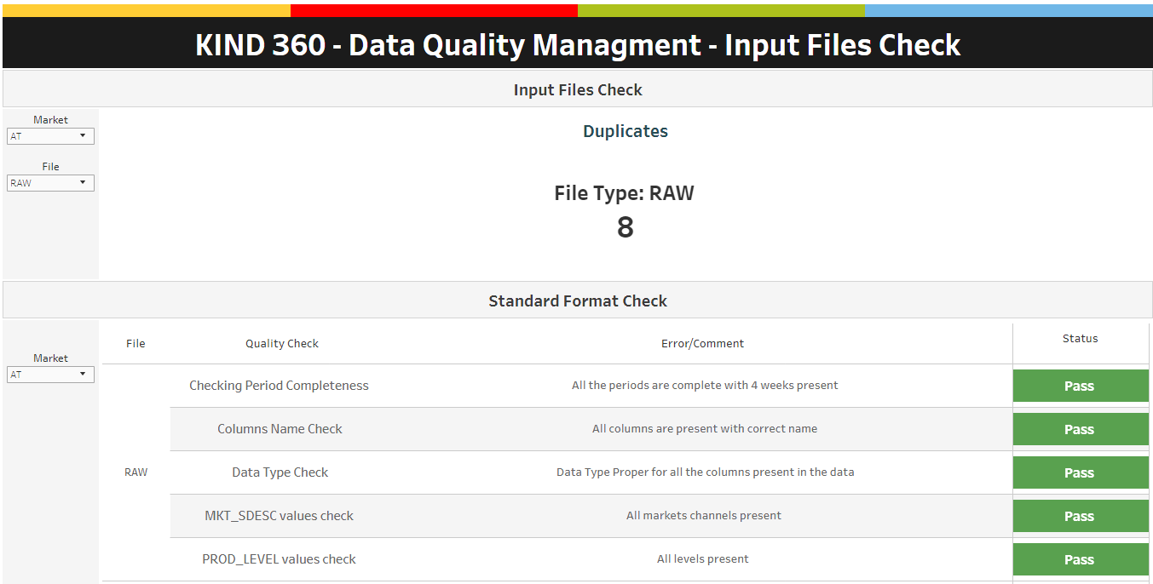
Raw data input is checked for standard format and necessary columns before processing

Slide 16
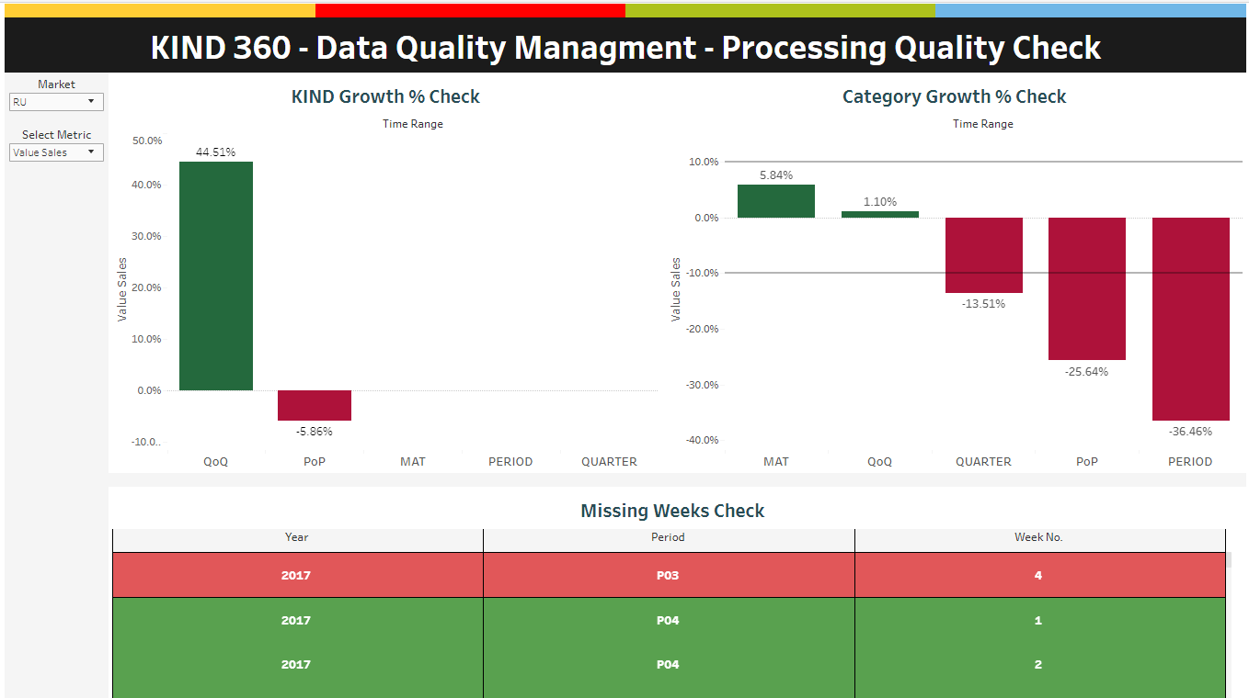
An anomaly detection framework is designed to check data on business sense and heuristics

Slide 17
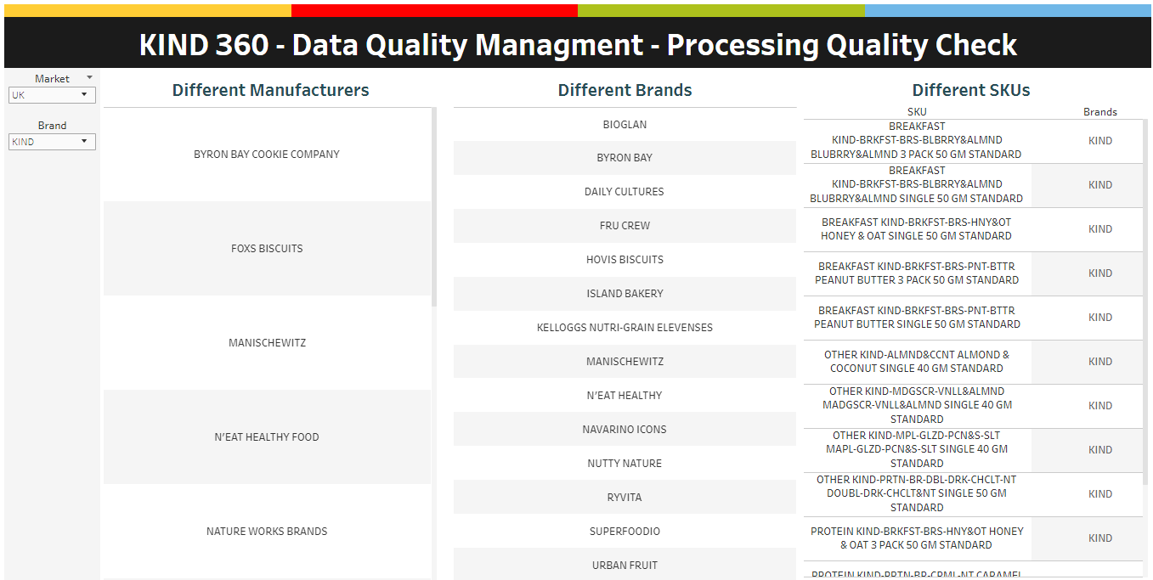
Dynamic identification of new data points helps to track, optimize the solutions and reduces time effort.

Slide 18
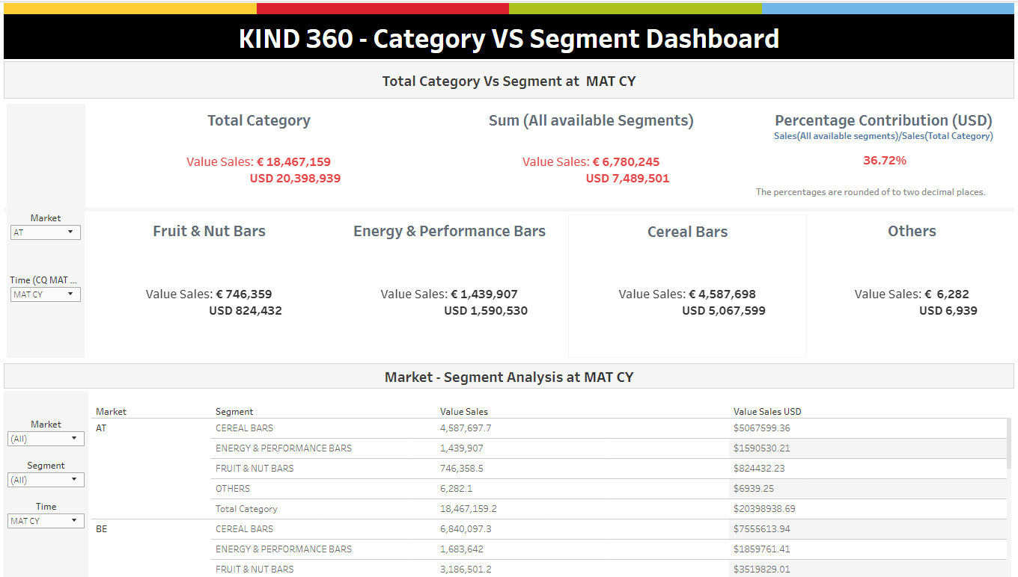
Comparison of aggregated metrics at different levels helps to identify any discrepancy in the data

Slide 19
Appendix

Slide 20
The KIND 360 Project serves as the foundation of the analytical journey embarked by KIND by acting as a one-stop shop for data and reducing time to insight
One Platform. All Data.
Data – driven decisions
Nielsen Sales Data
Dunnhumby Consumer Data
Mediacom Media Data
Holistic Performance
Assessment
Helios Financial Data
Manual Uploads
Faster Insights

Slide 21








The 360 Project includes 6 performance dashboards answering key business questions catering to 19 markets
Customer
Media
Price
Product
Consumer
Financial Health
Channel
Sales

Slide 22
Thank You

